Slide 1
Telling Your Story with Data
Darwin Wade, Past NCDA Board Member, Grand Prairie, TX

Slide 2
Overview
Why data storytelling matters for public trust
What funders and elected officials expect to see
Using dashboards to track spending and outcomes
Real-life examples and best practices from NCDA communities
“I see the outputs, but I’m more concerned about the outcomes and impact. How are we moving the needle?”
Michael Glaspie, Former Arlington, TX City Council Member

Slide 3
Why Data Storytelling Matters Today
Public dollars demand public trust
Decision-makers want clarity, not complexity
Data helps move from anecdotes to evidence
Data isn’t just numbers, its proof of stewardship

Slide 4
What Local, State, and Federal Leaders Want to Know
Where did the money go?
Who benefited?
What changed as a result?
Can this be replicated or scaled?
Notes:
Dashboards help answer these questions quickly and transparently.

Slide 5
Going From Data to Narrative
Inputs → Activities → Outputs → Outcomes → Impact
Use plain-language explanations
Use visuals, info graphics, real-time dashboard metrics
Testimonials of beneficiaries and community residents
Example:
$ invested: HOME funds + leveraged dollars
# families assisted/stabilized
% reduction/improvement
Notes:
Instead of just saying we spent $5 million in HOME funds, we say: We invested $5 million, leveraged another $8 million, helped 120 families become homeowners, and reduced housing cost burden by 18%. That’s a story policymakers understand.

Slide 6

Why Dashboards Work
Real-time or regularly updated
Easy to share with stakeholders and residents
Supports transparency and accountability
Reduces repetitive reporting

Slide 7
Key Metrics That Matter
Dollars expended vs. Dollars leveraged
Projects completed or underway
People served/communities impacted
Outcomes aligned with HUD Con Plan/Action Plan Goals and governing body priorities

Slide 8
How NCDA Communities Are Being Heard
Dashboards aligned with grant goals and policy priorities
Clear visual instead of dense report
Consistent reporting builds credibility over time
Plain-language storytelling
Accessible, shareable formats
Resident voices through interviews and testimonials
“If they can see it, they can support it.”

Slide 9
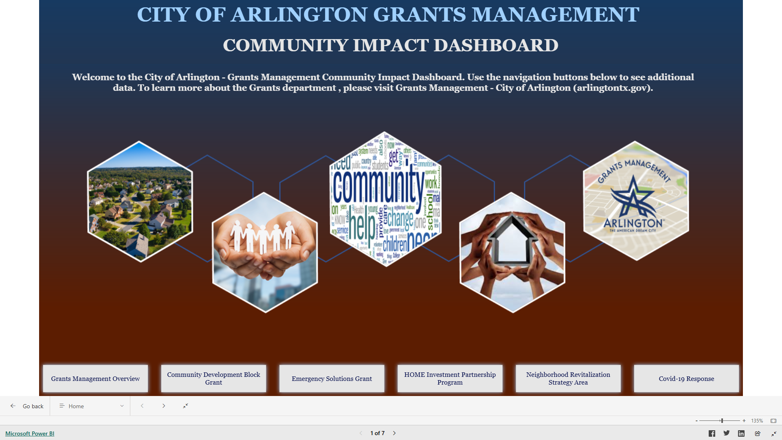

Slide 10
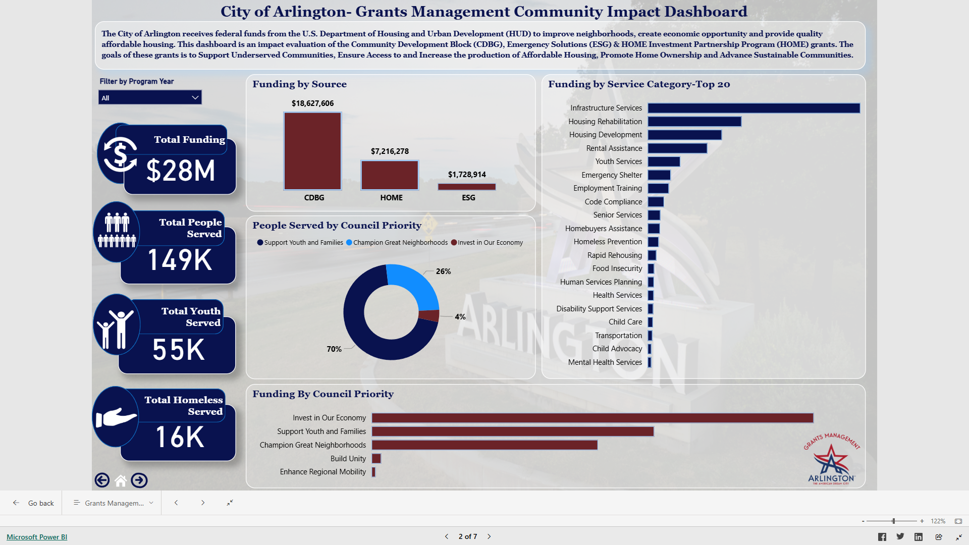

Slide 11
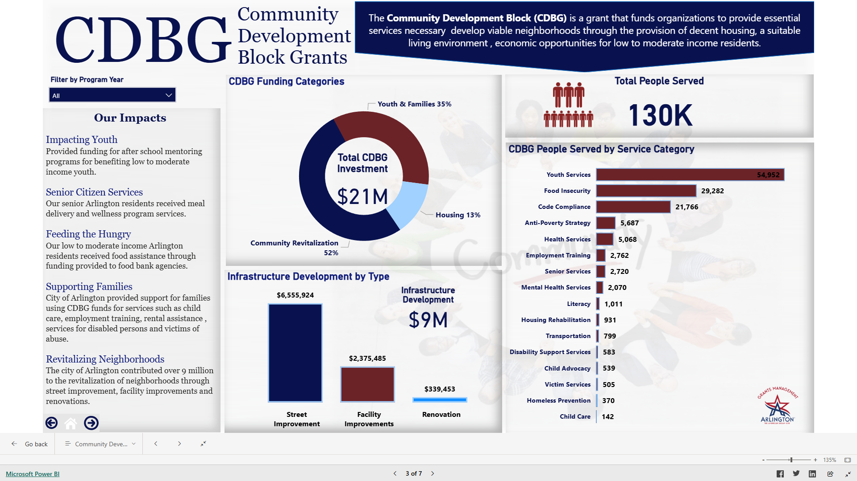

Slide 12
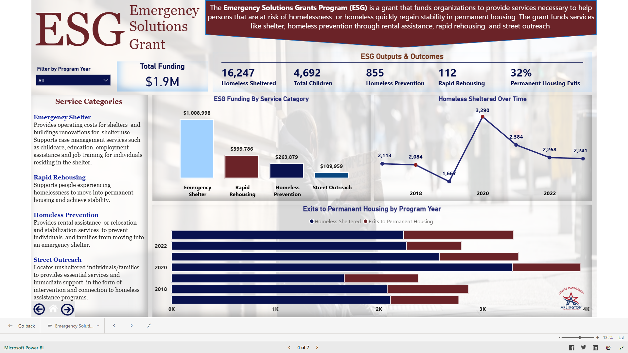

Slide 13
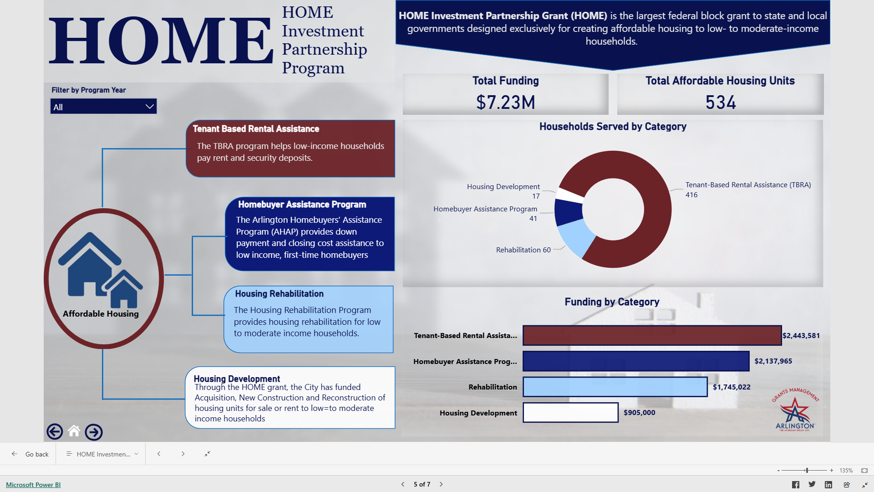

Slide 14
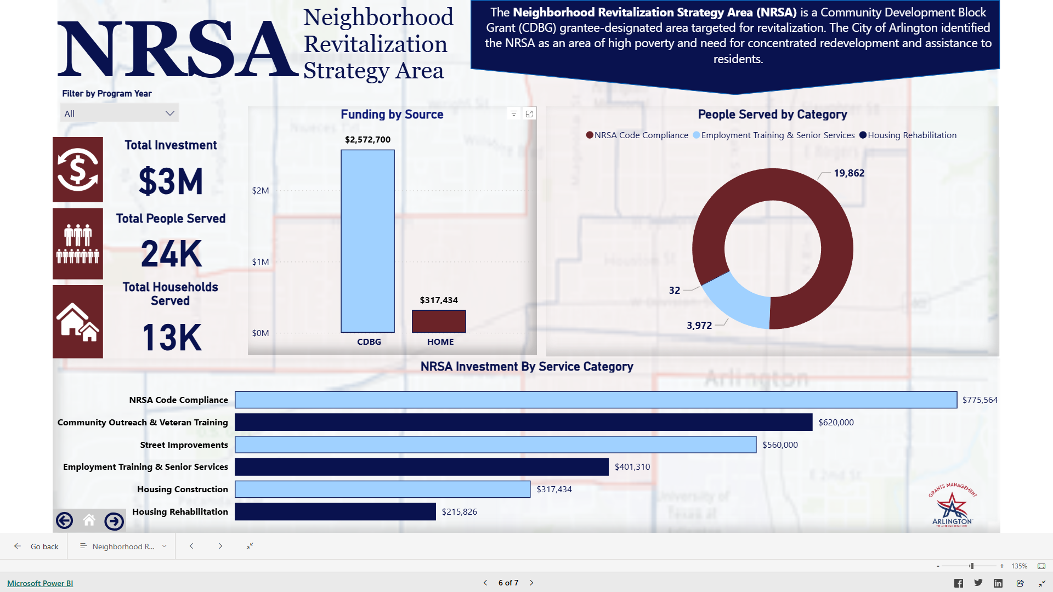

Slide 15
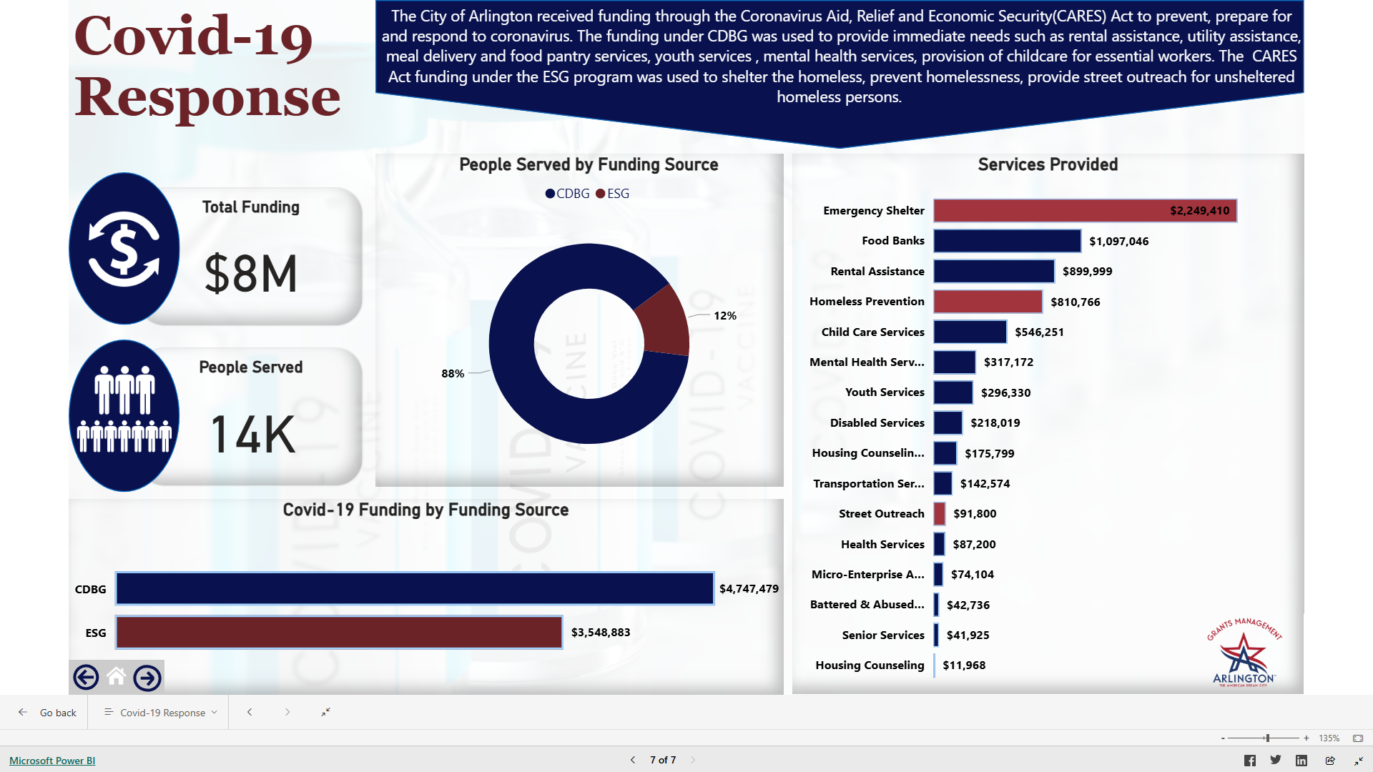

Slide 16

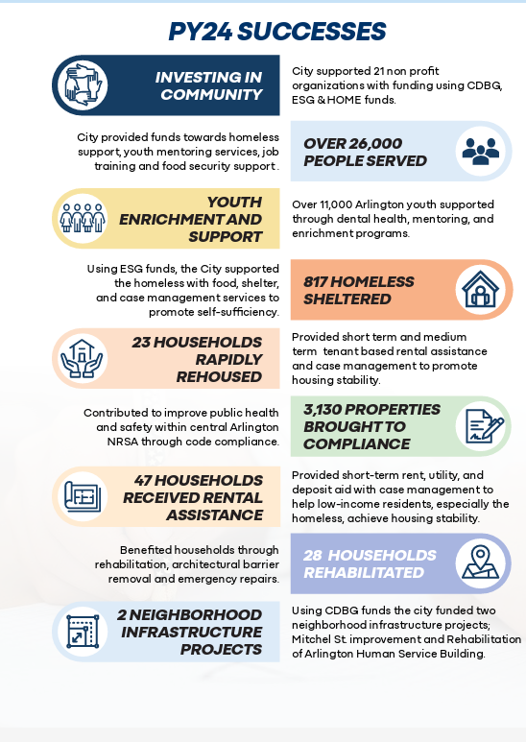
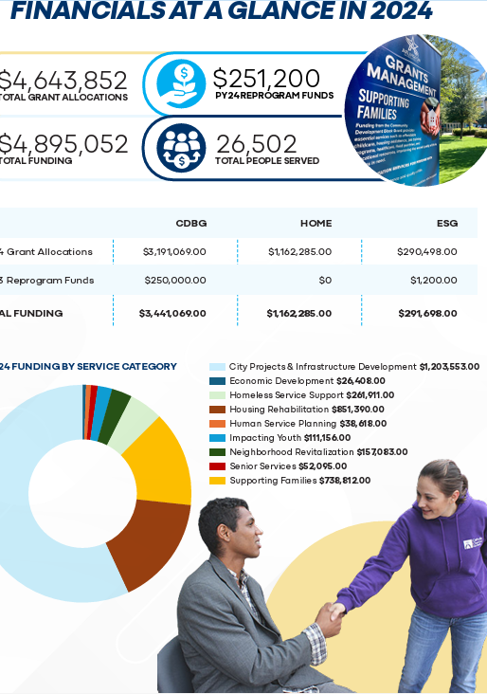

Slide 17

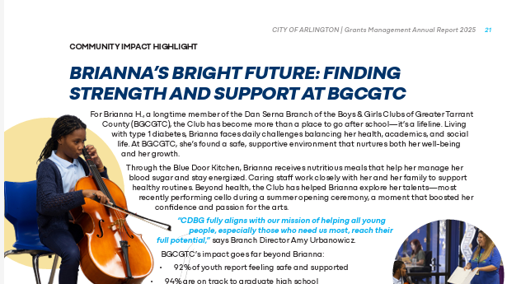
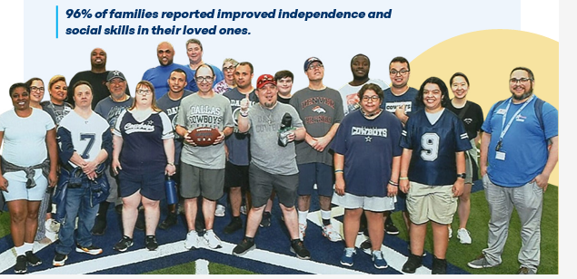
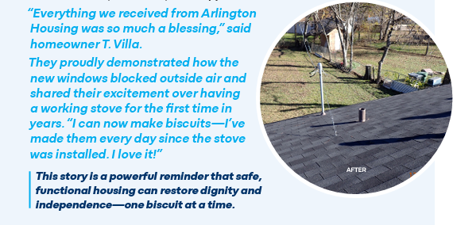

Slide 18
Lessons Learned & Common Mistakes
Tracking the wrong data—or too much data
Waiting until reporting deadlines to communicate
Assuming data speaks for itself
Overbuilding dashboards too early
Misalignment with funding and policy goals
Treating data as compliance only

Slide 19
Final Takeaway
Transparency builds trust
Stories build understanding
Data builds confidence
“Tell your story clearly and decision-makers/residents will listen.”

Slide 20
Questions?

